Slide 1
Automated Analysis on Relationships between Natural Language Requirements
Li Yi
from Domain and Requirements Engineering Research Group
2011.10.18

Slide 2
Why do I Choose this Topic
Our recent work focuses on automated finding constraints between features in a feature model.
Is a kind of relationship
Encapsulates a set of coherent requirements, often described in natural language
Automated Analysis on Relationships between
Natural Language Requirements

Slide 3
Agenda
Introduction
Related Work
Our Work

Slide 4
The Need of NLP in Requirements Analysis (RA)
Documents to be Analyzed
RA is the first -- and in many cases, is claimed as the most crucial -- stage in software development process.
Written in Unconstrained Natural Language
79%
“Market Research for Requirement Analysis using Linguistic Tools” -- Luisa M. et al., RE Journal, 2004
(Data is collected from 142 software companies.)

Slide 5
Recent Research on RA-NLP
Inner-Requirements: Analyze individual requirements
Daniel M. Berry et al. / Hui Yang et al.: Ambiguity in Natural Language Requirements
Inter-Requirements: Analyze relationships between requirements
Requirements & Other Artifacts
Arantza Aldea / Annie I. Antón et al.: Law/Regulation
M. Ali Babar et al.: UML Models
Today’s Topic

Slide 6
2 Ways to RA-NLP
Statistical: Analyze text based on probabilities
Keywords: Term Frequency, Inversed Document Frequency, Similarity, …
Linguistic: Analyze text based on the grammar and semantics
Keywords: Part-Of-Speech, WordNet, Ontology, …

Slide 7
Agenda
Introduction
Related Work, Type I: Statistical Approach
Related Work (Type II)
Our Work

Slide 8
Work #1: Overview
J. Natt och Dag et al. (Sweden)
RE Journal, 2002. A Feasibility Study of Automated Natural Language Requirements Analysis in Market-Driven Development
…
Empirical Software Engineering, 2005. An Experiment on Linguistic Tool Support for Consolidation of Requirements from Multiple Sources in Market-Driven Product Development
Which Relationship?
Similarity
Simple Method, but Thorough Experiments with Real Data

Slide 9


The 2002 RE Journal Paper
In Telelogic Techs AB (a famous CASE company in Sweden), requirements are collected like this:
Input Requirements Candidates
Quality Gateway
Completeness Analysis
Approved
Requirements Database
Ambiguity Analysis
Requirements Engineer
Issuer
Request for Clarification
Similarity Analysis
The authors focus on automating this

Slide 10
The 2002 RE Journal Paper
In Telelogic Techs AB (a famous CASE company in Sweden), requirements are collected like this:
Input Requirements Candidates
Quality Gateway
Completeness Analysis
Approved
Requirements Database
Ambiguity Analysis
Requirements Engineer
Issuer
Request for Clarification
Similarity Analysis

Slide 11
The 2002 RE Journal Paper
In Telelogic Techs AB (a famous CASE company in Sweden), requirements are collected like this:
Input Requirements Candidates
Quality Gateway
Completeness Analysis
Approved
Requirements Database
Ambiguity Analysis
Requirements Engineer
Issuer
Request for Clarification
Similarity Analysis

Slide 12
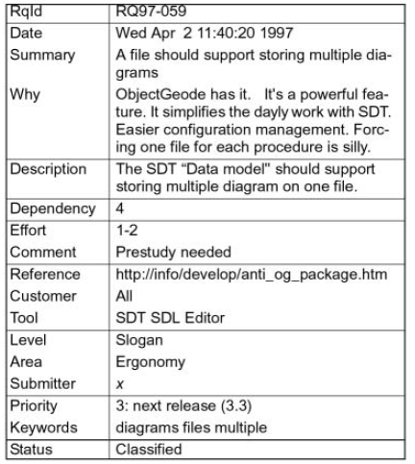
The Form of Requirements
Useful fields
6 Status
New
Classified
Duplicated
Assigned
Implemented
Rejected

Slide 13
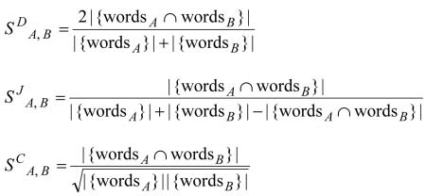
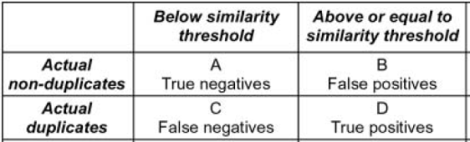
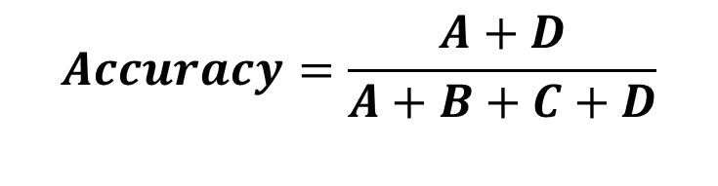
Automated Similarity (Duplicate) Analysis
Similarity Calculation: 3 Methods
Is_Duplicated (A, B): S_{A, B} >= Threshold
Measurement
(Dice)
(Jaccard)
(cosine)
$$Accuracy=\frac{A+D}{A+B+C+D}$$

Slide 14
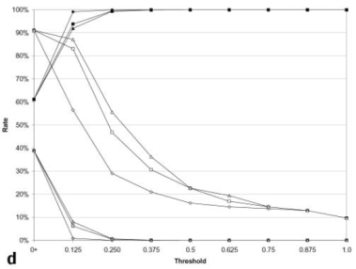
Empirical Study
Data
Full Set: 1891 requirements from Telelogic AB.
Reduced Set: 1089 out of these 1891 requirements have already been analyzed by human.
162 Experiments
3 similarity calculation methods
2 data sets
3 fields: Summary, Description, or Summary + Description
9 duplicate thresholds
Accuracy (3 Methods)
Example:
Data Set = Reduced
Field = Summary
True Positives (3 Methods)
False Positives (3 Methods)
Threshold

Slide 15
Results
The approach gives reasonably high accuracy.
Dice and Cosine give better results.
A large textual field (Description) tends to give worse results; it should only be used when the Summary field contains too few words
The approach finds missing duplicates
Give the experts 75 False Positives under {method = cosine, threshold = 0.75, set = full, field = Summary}, 28 are eventually become True (i.e. previously missed by human)

Slide 16
Work #2: Overview
Chuan Duan, Jane Cleland-Huang et al.
RE Journal 2009. Towards Automated Requirements Prioritization and Triage
Which Relationship?
Ordering
An interesting idea based on a deep thought of the nature of requirements

Slide 17
The (Basic-) Basic Idea
Human work in requirements prioritization
Old Way: Prioritize thousands of individual requirements
New Way: Prioritize dozens of requirements clusters
Reduced
Auto
Manual
Auto
…
Individual Requirements
Requirements Clusters
Sorted Clusters
Sorted Requirements

Slide 18
What Makes it Interesting?
The Nature of Requirements:
An individual requirement often plays a complex and diverse role.
For example, an individual requirement may:
- address both functional and non-functional needs
- involve several functionalities
The Extended Basic Idea
1. Multiple Clustering Criteria: FR, NFR, Business Goal, etc.
Run “Basic-Basic Idea” multiple times (1 criterion a time), then summarize
2. Fuzzy Clustering: An individual requirement belongs to each cluster at certain probability

Slide 19
Multiple Clustering Criteria
By Feature: Traditional clustering on text similarity
By NFR: Calculate similarity between pre-defined NFR keywords and the requirements, and top X% similar requirements belong to the NFR
Because only a part of requirements address NFRs.
By Business Goal: … between pre-written goal descriptions and the requirements, and …
… (By other pre-written textual materials)

Slide 20
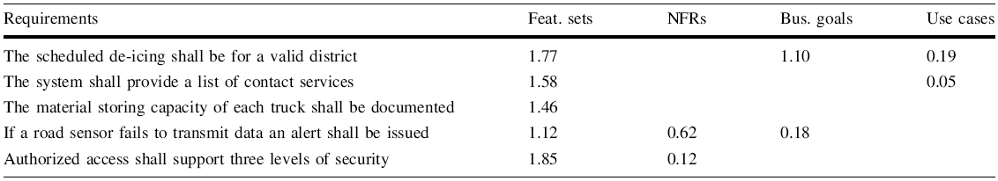
An Example
Blank means not related
Calculate Final Score
Manually assign weights to each criteria, e.g. Feature = 0.5, NFR = 0.2, Business Goal = 0.3
Final Score = Weighted Sum, e.g. Req. 1’s Final Score = 1.77 * 0.5 + 1.1 * 0.3

Slide 21
Case Study
Ice Breaker Systems: 202 requirements
The prioritized requirements are divided into 5 groups (Requirements Triage):
Must Have: Top 20%
Recommend Having: Next 20%
Nice to Have: …
Can Live Without: …
Defer: …
Results:
Inclusion Error (False Important): 17%
Exclusion Error (False Non-important): < 2%
Important
Not Important

Slide 22
Agenda
Introduction
Related Work (Type I)
Related Work, Type II: Linguistic Approach
Our Work

Slide 23
Work #3: Overview
Nathan Weston, Awais Rashid
RE Journal 2009. Formal Semantic Conflict Detection in Aspect-Oriented Requirements.
Which Relationship?
Conflict
A Weak-Automated Approach

Slide 24
Background
Aspect-oriented Requirements (AORs): Separated requirements for each concern.
The Traditional Way to Composition: Syntactically
Concern: Customer
Req 1: The customer selects the room type to view room facilitates and room rates.
Req 2: The customer makes a reservation for the chosen room type.
Concern: CacheAccess
Req 1: The system looks up cache when:
1.1: room type data is accessed;
1.2: room pricing data is accessed.
Composition:
Aspect name = “CacheAccess” req_id = “all”
Base name = “Customer” req_id = “1”
Constraint action = “provide” operator = “for”

Slide 25
The Proposed Approach
Semantic Tagging
AORs
Semantic Composition
Formalization
LEGEND
First Order Temporal Logical Formula
Automated
Conflict Detection
Manual

Slide 26
Semantic Tagging
The sentences in AORs are tagged with linguistic attributes
It can be done with tools like WMatrix
The customer selects the room type to view room facilitates and room rates.
Subject
Object
Object
Object
Relationship: type = “Mental Action”, semantics = “Decide”

Slide 27
Semantic Composition
Query matches one or more requirements
Composition:
Aspect Query: relationship = “look up” AND object = “cache”
Base Query: subject = “frequently used data” OR object =
“frequently used data”
Outcome Query: relationship = “update” AND object = “cache”
Constraint: aspect operator = “apply”
base operator = “meets”
outcome operator = “satisfied”
Time
Interpretation: “Look up cache” happens just before (meets) the access of “frequently used data”, the result must satisfy the requirements specifying “update cache”.

Slide 28
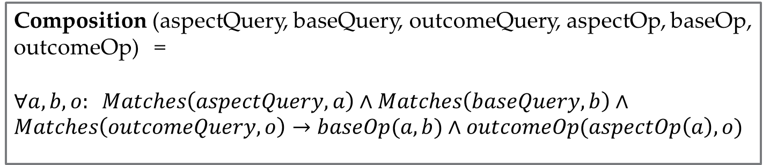
Formalize the Composition
Composition (aspectQuery, baseQuery, outcomeQuery, aspectOp, baseOp, outcomeOp) =
$∀a, b, o: Matches\left(aspectQuery, a\right)∧Matches\left(baseQuery, b\right)∧Matches\left(outcomeQuery, o\right)→baseOp(a, b)∧outcomeOp(aspectOp\left(a\right), o)$
Interpretation: Apply the aspect to base under the condition of baseOp, while ensuring that the aspectOp is correctly established and the conditions of outcome are upheld.

Slide 29
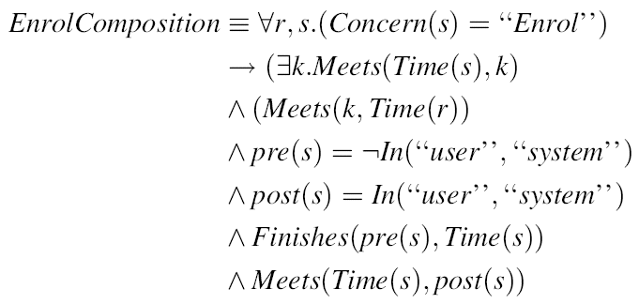
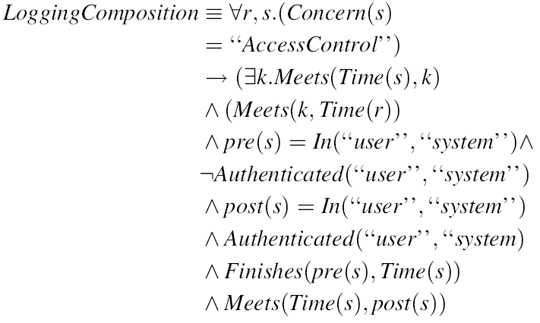
Example
Time

Slide 30
Conflict Detection
1. Check temporal overlap between compositions.
2. If overlapped, use a theorem prover to find logical conflicts. NOTE: Only the conflicts on the same predicates can be found automatically.
In Previous Example
Conflict! Reason: Both “Enroll” and “Login” state that “it happens before everything.” Fix: Change “Login” to “it happens before everything except Enrollment.”

Slide 31
Agenda
Introduction
Related Work (Type I)
Related Work (Type II)
Our Work: Mining Binary Constraints in Feature Models (Mainly a statistical approach, but with the help of linguistic tools.)

Slide 32


Background & Motivation
Feature Model
Build: Requirements Feature + Constraints
Reuse: Select features without violating constraints
But building constraints is not an easy task
Problem Size: O(|Feature|²)
Abstract, Indirect: Learn from several products
We try to provide some automated support for finding constraints
Music Player
WAV Codec
Burn CD
Platform
$$×$$
Mobile
PC
Optional
Mandatory
XOR-Group
Requires
$$×$$
Excludes

Slide 33
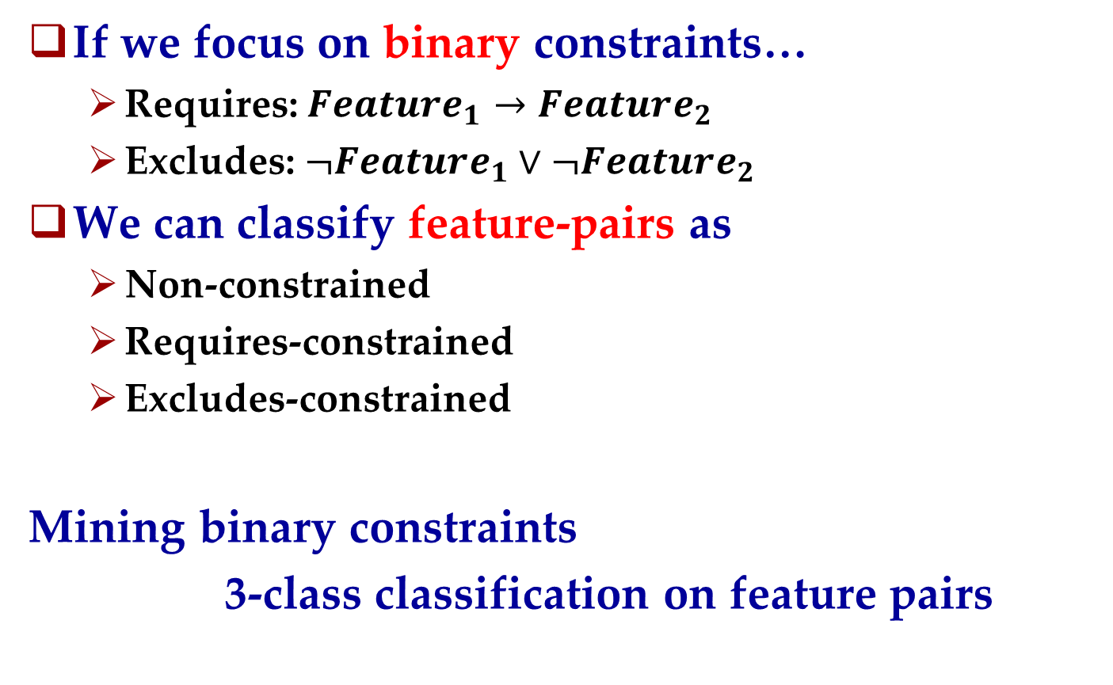
Our Basic Idea
If we focus on binary constraints…
Requires: $Feature_{1}→Feature_{2}$
Excludes: $¬Feature_{1}∨¬Feature_{2}$
We can classify feature-pairs as
Non-constrained
Requires-constrained
Excludes-constrained
Mining binary constraints
3-class classification on feature pairs

Slide 34
Approach Overview
Training & Test FM(s)
Make Pairs
Training & Test Pair(s)
Stanford Parser
Quantify Pairs
Training Vector(s)
Classifier
Optimize & Train
Trained Classifier
LEGEND
Test Vector(s)
Test
Automated Action
Classified Test
Pair(s)
Data
Tool

Slide 35


Make Pairs
The pairs are cross-tree only and unordered
Cross-tree only: The 2 features in a pair have no “ancestor-descendant” relation
(The inner-tree constraints are better expressed by refinement relationships.)
Feature Tree
A
$$×$$
B
C
(A, B) (A, X) (A, Y) (A, C) (B, X) (B, Y)
.
.
.
.
.
.
X
…
Y
(B, C) (X, Y) (C, X) (C, Y)
Unordered: (A, B) == (B, A) Therefore is_requires(A, B) means A requires B or B requires A or both

Slide 36
Quantify Pairs
Feature Pair
Feature Pair
name₁: String
name₂: String
description₁: Text
description₂: Text
attribute₁: Number
attribute₂: Number
…(more)
Classifiers work with numbers only.
We measure 4 numeric attributes for pair (A, B)
Similarity between A.description and B.description
Similarity between A.objects and B.objects
Similarity between A.name and B.objects
Similarity between A.objects and B.name

Slide 37
Quantify Pairs
Feature Pair
Feature Pair
name₁: String
name₂: String
description₁: Text
description₂: Text
attribute₁: Number
attribute₂: Number
…(more)
Classifiers work with numbers only.
We measure 4 numeric attributes for pair (A, B)
Similarity between A.description and B.description
Similarity between A.objects and B.objects
Similarity between A.name and B.objects
Similarity between A.objects and B.name
Similar Feature
Overlapped Function Area
One is targeted by another
These phenomena may indicate dependency / interaction between the paired features, and in turn, indicate constraints between them.
The similarity is calculated by tf-idf (term frequency, inversed document frequency) and cosine method.

Slide 38
Extract Objects
We use Stanford Parser to perform grammatical analysis on feature descriptions. (It supports both English and Chinese.)
For English sentences, we extract objects (direct, indirect, prepositional) and any adjectives modifying the objects.
An Example
Use a PDF driver to output or publish web calendars so anyone on
your team can view scheduled events.
Direct Objects
Direct Objects
Adjective Modifier
Direct Object

Slide 39
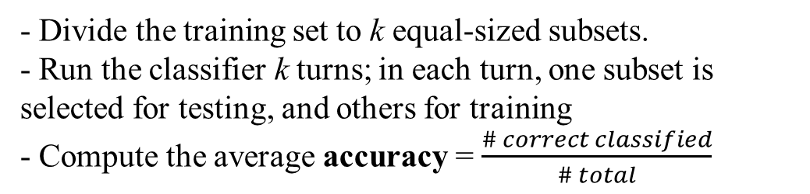
Train and Optimize the Classifier
We use LIBSVM, a support-vector classifier
Running k-fold cross validation on the training set, we get the classifier accuracy.
Different classifier parameters give different accuracy
Optimize the classifier: We use a genetic algorithm to find best parameters
- Divide the training set to k equal-sized subsets.
- Run the classifier k turns; in each turn, one subset is selected for testing, and others for training
- Compute the average accuracy = $\frac{\# correct classified}{\# total}$
k = 4

Slide 40
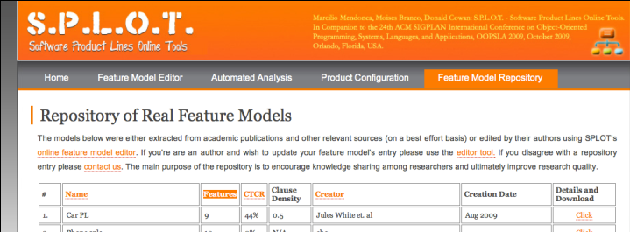
Experiments: Data Preparation
Data: 2 feature models from SPLOT Feature Model Repository (no feature description)
Graph Product Line: by Don Batory (81 pairs)
Weather Station: by pure-systems corp. (186 pairs)
Add Feature Description
Most features are terms defined on Wikipedia, we use the first paragraph (i.e. Abstract) as descriptions.

Slide 41
Experiment Design
2 Categories
Generate Training & Test Set
Optimize, Train and Test
Result
No Feedback
Generate Initial Training & Test Set
Training & Test Set
Optimize, Train and Test
Check a few predicted constraints
Result
Limited Feedback
(An expected practice in real world)
Add checked results to training set;
Remove checked results from test set
4 Training / Test Set Selection Methods
1. Training = FM₁, Test = FM₂
2. Training = FM₁ + Small Part of FM₂, Test = Rest of FM₂
3. Training = Small Part of FM₂, Test = Rest of FM₂
4. The same as 3, but do Iterated Labeled-Unlabeled (LU) Training

Slide 42
Some Results
Comparison of Selection Methods
Small Part = 1/5, Test FM = Graph Product Line (81 pairs, including 8 requires and 1 excludes)
Method | Accuracy | Requires |  | Excludes
 |  | Precision | Recall | Precision | Recall
1 | 77.78% | 22.72% | 83.3% | -- | 0
2 (Run 5 times) | 84.01% | 45.54% | 52% | 100% | 20%
3 (Run 5 times) | 88.31% | 69.44% | 21.02% | 100% | 20%
4 (Run 5 times) | 89.23% | 76.08% | 23.25% | 100% | 20%
Effect of Limited Feedback (Check 3 Predictions)
Accuracy (%)
Accumulated Feedback #

Slide 43
Summary & Future Work
Summary
A mixed approach (statistical process + linguistic tools)
Define attributes according to possible dependency or interaction between paired features
Method 1 (gives higher recall) and Method 4 (gives higher precision) may be preferred
Limited Feedback can improve the classification
Future Work
Incorporate the Stanford Parser for Chinese into our feature modeling tool, and therefore we can do evaluation in real scenes.

Slide 44
THANK YOU ! Q&A

